Slide 1
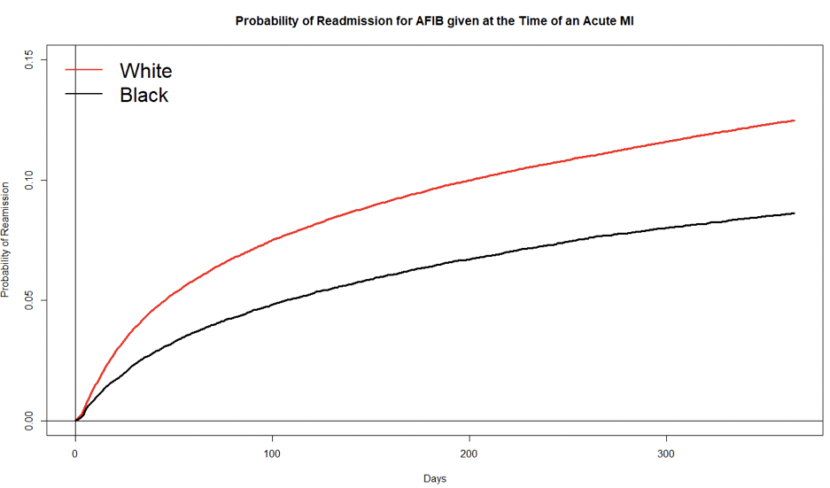
Readmission and Mortality Among Heart Failure Patients in a Statewide Database
The number of patients with HF declined between 2000 and 2006 and remained unchanged thereafter (p<0.001).
Add CIs
The rate of readmissions for any cause increased during the study period (p<0.001) while the rate of HF readmissions and mortality remained relatively unchanged.
All Cause Death
Readmitted
Not readmitted
Patients that had been readmitted within a year exhibited a significantly higher 3-year mortality (p<0.001).

